Slide 1






ONLINE FOOD ORDERING SYSTEM

Slide 2


PROBLEM STATEMENT
"Our project addresses the inefficiencies and complexities of traditional food ordering systems by creating an intuitive online platform that enhances convenience, efficiency, and customer satisfaction in the dining industry."

Slide 3
SOLUTION
“Our project revolutionizes the dining experience by offering a seamless platform for customers to browse menus, place orders, and make payments effortlessly. With user-friendly interfaces and advanced features, we aim to streamline the food ordering process for both restaurants and customers."

Slide 4

Detailed Management Collection: Efficiently gather detailed management data.
Time-saving: Quickly highlight yearly management trends.
Cost Reduction: Lower expenses associated with data collection.
Streamlined Procedures: Smooth operation for current and future tasks.
Business Process Automation: Computerize various aspects of the Online Food Ordering System for enhanced efficiency.
Enhanced Understanding: Facilitate a clear understanding of past and present management practices.
SCOPE

Slide 5
Product and Component-based: Organize orders and items efficiently.
Easy Issue Management: Seamlessly create, edit, and track issues.
Flexible Querying: Dive deep into issue lists for detailed insights.
User Account Control: Maintain security and manage access effectively.
Simplified Status Tracking: Monitor progress and resolutions effortlessly.
Multi-level Prioritization: Set priorities and severities for better task management.
File Attachments and Comments: Provide additional information for better context.
Robust Database Backend: Ensure data integrity and reliability.
FEATURES

Slide 6

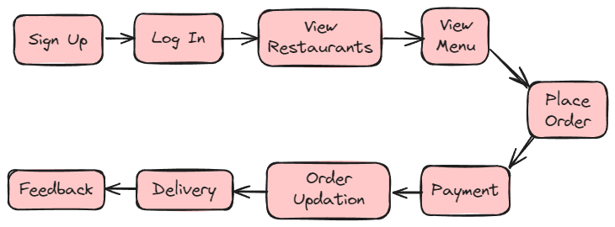
FLOW CHART
(USER)

Slide 7

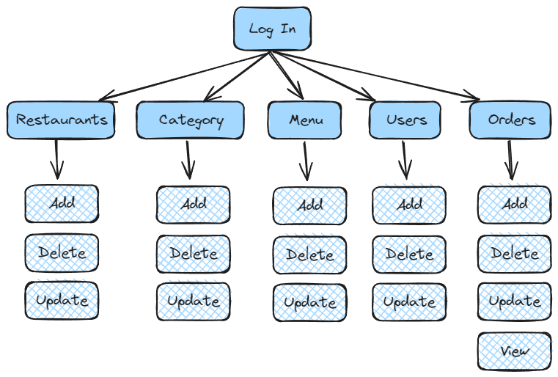
FLOW CHART
(ADMIN)

Slide 8

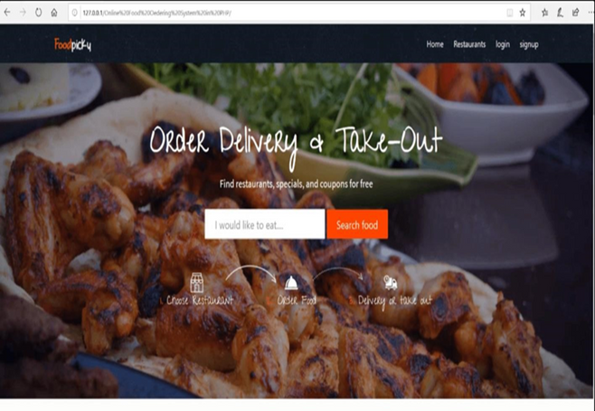

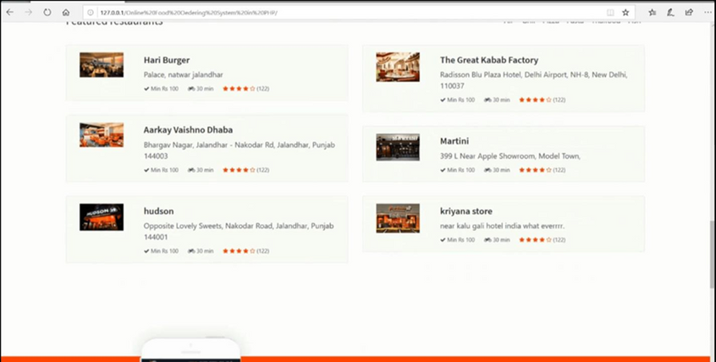
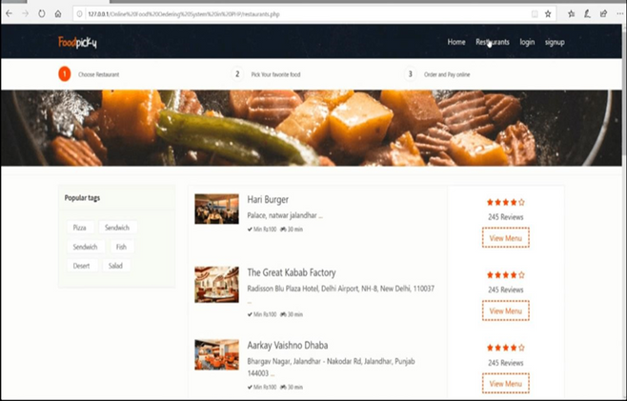

SCREENSHOTS OF THE
PROJECT

Slide 9
THANK YOU
Thank you all for being here today and engaging with our presentation. Your interest and feedback mean a lot to us. Let's continue to learn and grow together.

